Slide 1
Economics
Week #10

Slide 2
Topics of Week #10
Loanable Funds Market
Aggregate Demand*
Aggregate Supply*
Macroeconomic Equilibrium*
Classical vs. Keynesian*
"*" Indicates the most important topics.
Mateer and Coppock: Chapter #22, #26 and #27

Slide 3
The Loanable Funds Market
Loanable funds market
Includes places like stock exchanges, investment banks, mutual fund firms, and commercial banks.
Borrowers get funds to use for businesses.
Savers lend to these businesses.
Notes:
The loanable funds market is not a single physical location but includes places like stock exchanges, investment banks, mutual fund firms and the commercial banks where we all have accounts.
In this chapter, we'll see that this market is extremely important. Without it, much investment would be impossible, and production and GDP would falter.

Slide 4
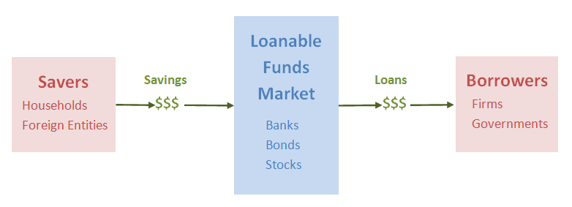
Loanable Funds Market
Notes:
Overall picture:
Savings flows in and this is translated into loans for borrowers. We could call it the market for savings, or even the market for loans. The term "loanable funds" captures the information in both: peoples' savings are funds available for loans to borrowers, or loanable funds.
Left side:
The suppliers of funds (savers) include households, and foreign entities. These foreign entities include both the private citizens and governments that decide to save in the United States. Household savings in retirement accounts, stocks, bonds, and mutual funds are other big sources of loanable funds.
Right side:
The demanders of loanable funds include business firms and governments. Firms demand borrowed funds to finance large expenses, such as capital purchases or business expansions.

Slide 5
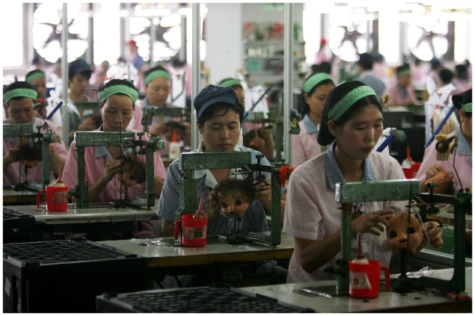
Production Timeline: Firms Need to Borrow
Firms need to borrow before production begins. That is why the loanable funds market is so important.
Prepare to Produce
Produce
Sell Output
Borrow $$
Build Capital Goods
Hire Workers
Repay Loans $$
Pay Workers $$
Today
Future Periods
Time
Notes:
To reinforce the importance of this market, think about why borrowing takes place. The key reason is that firms' borrow to invest. That is, firms, looking to produce output in the future, must borrow to pay expenses today. Without borrowing, production may not take place, and this of course would greatly hurt the macroeconomy.
This figure was seen in the previous chapter. However, a different part of the figure is emphasized here.
Picture:
Before anything is produced in the factory, the investment must be paid. You have to borrow to build factories, warehouses, buy equipment, and hire workers!

Slide 6
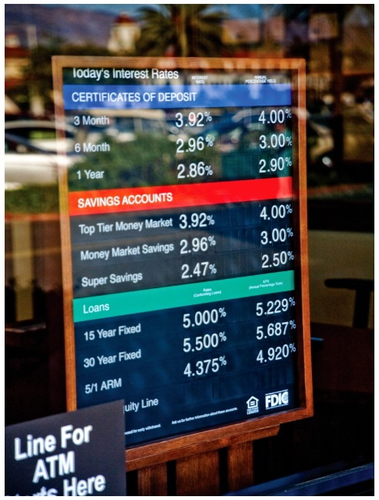
Interest Rates
Interest rate
The price of loanable funds
Savers: the reward for saving.
Borrowers: the cost of borrowing.
Like other prices, it rises and falls.
Affected by supply and demand.
We can examine this market like any other market.
Good | Loanable Funds
Price | Interest Rate
Sellers/Suppliers | Savers
Buyers/Demanders | Borrowers
Notes:
Many people, thinking about retirement, buying a house or car or some other big purchase, worry and fret over interest rate fluctuations and have no clear picture as to why interest rates rise and fall. The interest rate is just the price of loanable funds, and if you know how to use supply and demand, you can determine what makes interest rates rise and fall.

Slide 7
The Loanable Funds Market
Notes:
Savings is channeled into investment in the loanable funds market. In this market, loanable funds are the goods that are bought and sold. The price is an interest rate. This price, like any other market-determined price, is determined by the interaction of supply and demand.

Slide 8
Inflation and Interest Rates
Real interest rate
The interest rate corrected for inflation.
Nominal interest rate
The interest rate before it is corrected for inflation.
Fisher equation
Relates inflation to the real and nominal interest rate.
Notes:
Savers and borrowers care about the real rate of interest on a loan because this is the rate that describes how the real purchasing power of their funds changes over the course of the loan. Since interest rates are a result of supply and demand in the market for loanable funds, higher inflation rates lead to higher nominal interest rates in order to compensate lenders for the loss of purchasing power.
The difference between real and nominal interest rates is the rate of inflation.
Real interest rate is related to real purchasing power. The nominal rate of interest is just the "stated" rate.
Higher levels of inflation will lead to higher nominal interest rates, even when real interest rates are constant.

Slide 9
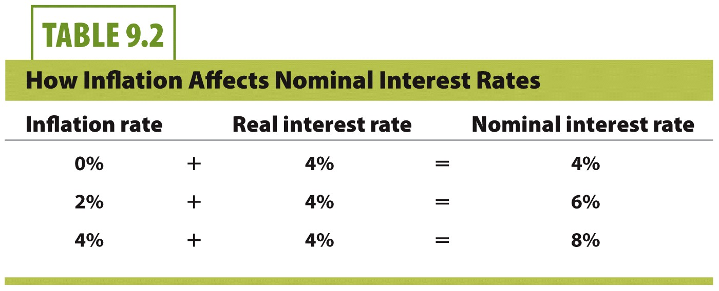
Fisher Equation Example
Notes:
If the real interest rate is 4% and there is no inflation, then the nominal interest rate is also 4%. But if inflation rises to 2%, the nominal interest rate increases to 6%. If the inflation rate rises further to 4%, then the nominal interest rate rises to 8%.

Slide 10
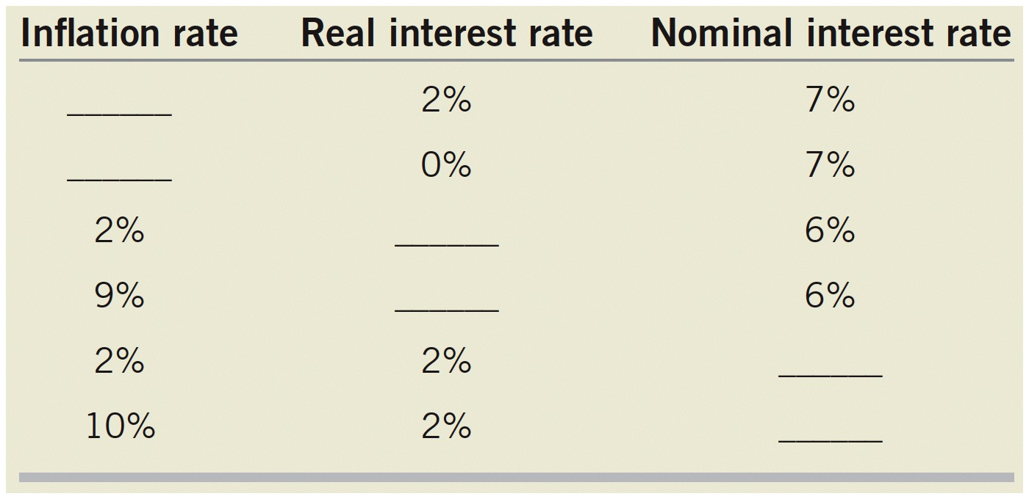

Slide 11
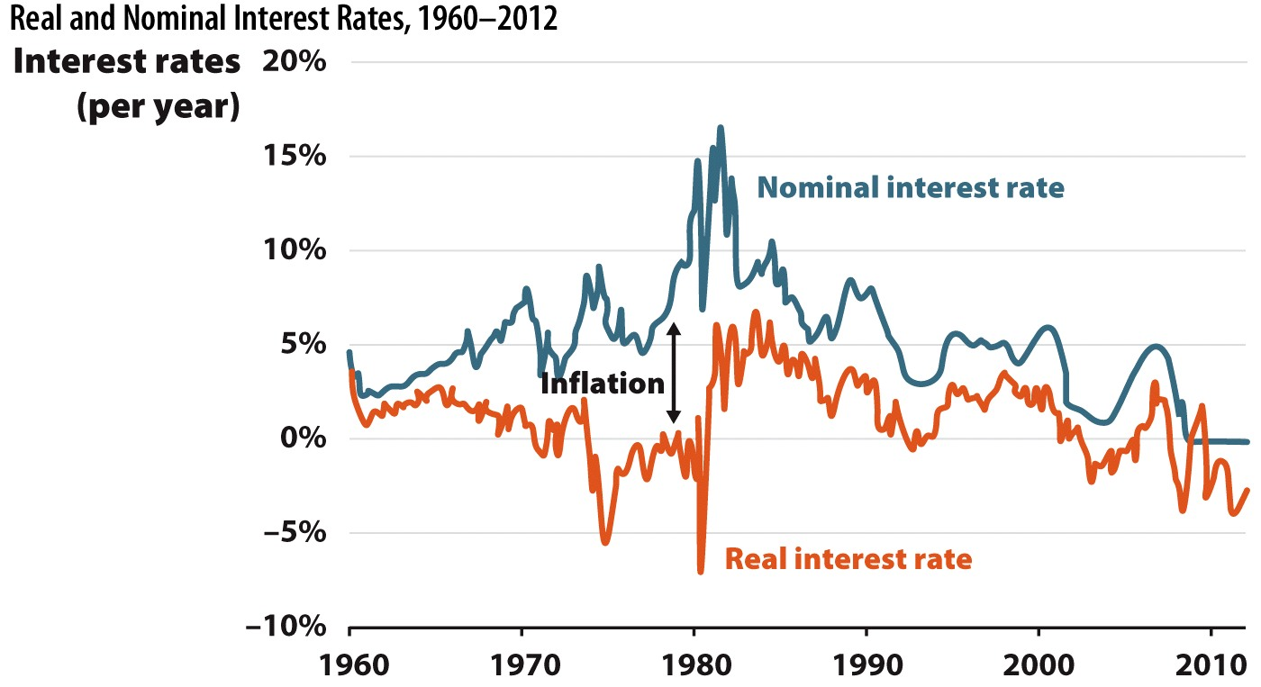
Real and Nominal Interest Rates, 1960–2012
Notes:
The difference between real and nominal interest rates is the rate of inflation. The experience of the 1970s illustrates that nominal interest rates are historically high when inflation is also high.

Slide 12

Quick Summary
Supply of loanable funds
Comes from people saving money.
Interest rate is a reward for saving.
Demand of loanable funds
Comes from people wanting to borrow money.
Interest rate is the cost of borrowing.

Slide 13
Practice What You Know
Where does the supply of funds in the loanable funds market come from?
Banks printing money.
Firms borrowing money for investment.
Government tax revenues from citizens.
Consumers saving their money at banks.
Notes:
Correct answer: D
In this market, consumers supply funds by saving, and firms (and other borrowers) demand funds to borrow.

Slide 14
Practice What You Know
The interest rate can be thought of as
the rate at which banks loan funds.
the return on a capital investment.
the real rate of inflation.
the price of money.
Notes:
Correct answer: D
Savers receive an interest rate as payment for lending their funds to borrowers.
Borrowers pay an interest rate when they take out a loan.

Slide 15
Aggregate Demand and Aggregate Supply Model
The model we use to study business cycle is the aggregate demand and aggregate supply model.
Aggregate means "Total."
Price level (P): Nominal variable that reflects current price changes without adjusting for inflation.
Real GDP (Y): Economy's output of goods and services, corrects the growth in the economy for prices.
Aggregate demand (AD)
Total demand for final goods and services in the economy.
Aggregate supply (AS)
Total supply of final goods and services in the economy.
Notes:
There are a couple of differences:
We are aggregating, so instead of getting the price and quantity of ONE good, we are looking at the supply and demand for all goods in our economy. Aggregate = total.
We are not looking at a single price, but the price level. This will be on the vertical axis just like price was in the original model.
Overall output (or quantity) is real GDP. This is also known as Y.

Slide 16
Demand-Supply vs. Aggregate Demand-Supply Analyses
Demand and Supply Analysis:
Used in microeconomics.
Explain prices and quantities exchanged in individual markets.
Explains the quantity of an individual item produced over a certain period.
Explains how the price of one good is established in a market.
Aggregate Demand and Supply Analysis:
Used in macroeconomics.
Explains fluctuations in the aggregate production (real GDP) and the price level.
Explains the forces that influence aggregate production.
Explains how the price level, measured by a price index, such as the GDP deflator or the CPI, is established.

Slide 17
Aggregate Demand
Aggregate Demand (AD):
Total demand for final goods and services in the economy.
The spending/expenditure side of the economy.
Aggregate Quantity Demanded (AQD):
The total amount of final products (measured by Real GDP) that buyers will purchase at a given price level.
Aggregate Demand Curve:
Graph of the relationship between aggregate quantity demanded and price level.

Slide 18
Aggregate Demand
Remember the GDP Equation.
GDP = Income = Expenditure
GDP = C + G + I +NX
Since the expenditure is the demand of the whole economy we can say GDP = AD.
To calculate aggregate demand sum up the spending/expenditure from four sides of the economy as in the calculation of GDP.
Consumption
Government Purchases
Investment
Net Export
Notes:
To determine aggregate demand, we sum up spending from different sources in the economy.
[C] These sources include private domestic consumers who buy cars, food, clothing, education, and many other goods and services.
[I] Business firms are another major group; they buy resources needed to produce output.
[G] The government is a large purchaser of labor and other resources used to produce government services.
[NX] (net exports) Finally, foreign consumers buy many goods and services produced in the United States.

Slide 19
Aggregate Demand
GDP = C + I + G + NX
Consumption
Government
Purchases
Net
Exports
Investment
AD = C + I + G + NX
Notes:
To determine aggregate demand, we sum up spending from different sources in the economy.
[C] These sources include private domestic consumers who buy cars, food, clothing, education, and many other goods and services.
[I] Business firms are another major group; they buy resources needed to produce output.
[G] The government is a large purchaser of labor and other resources used to produce government services.
[NX] (net exports) Finally, foreign consumers buy many goods and services produced in the United States.

Slide 20
Aggregate Demand Curve
Graph of the relationship between AQD and price level.
Negatively-slopped:
Inverse relationship between aggregate quantity demanded and the price level.
Income:
In microeconomics, income is held constant as you move along the demand curve.
In macroeconomics, income is not held constant as you move along the aggregate demand curve. WHY?
GDP = Income = Expenditure

Slide 21
Aggregate Demand Curve
Notes:
The aggregate demand curve depicts the quantity of goods and services demanded in the economy at any given price level. For example, when the price level rises from P₁₀₀ to P₁₀₅ the quantity of aggregate demand falls from $16 to $15.5. Lower nominal price levels result in increased values of real GDP.

Slide 22
Aggregate Demand Curve
Three reasons for the inverse relationship between aggregate quantity demanded (AQD) and the price level:
The Real Wealth Effect
The Real Interest Rate Effect
The Foreign Trade Effect.
Assume that Government Purchases (G) is determined by policy instead of the price level, that means G is constant.

Slide 23
The Real Wealth Effect
The Real Wealth Effect:
A high price level can decrease real wealth in a nation and reduce consumption (C) on final products.
Lower C means lower quantity of goods demanded and lower AQD.
So high price level means low AQD.
Negative relationship between AQD and price level.
Notes:
When real wealth increases, this encourages consumers to spend more. Higher prices work in reverse by lowering the real value of money, making consumers poorer in the process. This results in reduced consumer spending and decreases the quantity of goods and services that they demand.
The wealth effect is related to the C in the GDP equation.

Slide 24
The Real Interest Rate Effect
The Real Interest Rate Effect:
A high price level can increase interest rates.
High interest rates make borrowing more expensive and reduce investment (I).
Lower I means lower quantity of goods demanded and lower AQD.
So high price level means low AQD.
Negative relationship between AQD and price level.
Notes:
The loanable funds market is just another market with supply and demand.
This graph is presented again to show that a reduction in savings will increase the interest rate.
People will reduce their savings if they feel like they have to spend more (for whatever reason).
There is an opportunity cost of borrowing. Higher interest rates make loans more expensive and decrease economic activity in sectors that are interest rate-sensitive.
The interest rate effect is related to the I in the GDP equation.

Slide 25
The Foreign Trade Effect
The Foreign Trade Effect:
A high price level reduces foreign demand for nation's exports (EX) and increases domestic demand for imports (IM).
Remember Net Export:
NX = EX - IM
Lower EX and higher IM means lower NX, lower quantity of goods demanded, and lower AQD.
So high price level means low AQD.
Negative relationship between AQD and price level.
Notes:
All else equal, if the U.S. price level rises, the quantity demanded of U.S. goods falls, as consumers from around the globe substitute out of U.S. goods and into goods produced in other nations.
When the U.S. price level rises, exports fall and imports rise, so net exports (X) fall. Similarly, when the U.S. price level falls, exports rise and imports fall, which means net exports rise. This is the international trade effect.
The international trade effect is related to the NX in the GDP equation.

Slide 26
Slope of the Aggregate Demand Curve
Notes:
When the price level rises, the quantity of aggregate demand falls. This negative relationship is due to three different effects.
1. The wealth effect implies a lower quantity of consumption (C) demand because real wealth falls at higher price levels.
2. The interest rate effect implies a lower quantity of investment (I) demand due to higher interest rates.
3. The international trade effect implies a lower quantity of net export (NX) demand due to relatively higher domestic prices.
Each effect focuses on a different component of aggregate demand.

Slide 27
Change in Aggregate Quantity Demanded
Aggregate Quantity Demanded (AQD):
The total amount of final products (measured as Real GDP) that buyers will purchase at a given price level.
Change in AQD:
Change in the amount of a nation's final product that will be purchased caused only by a change in the price level.
Caused by a change in the price level.
Movement along the AD curve.
NO SHIFT!

Slide 28
Change in Aggregate Demand
Change in AD:
Change in the amount of a nation's final product that will be purchased caused by something other than a change in the price level.
SHIFT in AD!
Decrease in AD: Left shift.
Increase in AD: Right shift.
Caused by changes in some factors that in turn effects the components of GDP which are C, G, I, and NX.
AD = GDP = C + I + G + NX
Notes:
Movement: a movement from A to B along the same graph can illustrate the slope of the graph
Shift: a "new" AD curve is created, shifting to the right or left from the original curve.
Text: A shift occurs when a violation of ceteris paribus

Slide 29
Aggregate Demand Shifters
1. Domestic Factors
Anything that changes major spending habits of domestic individuals and firms will shift AD:
Real Wealth
Real Interest Rate
The Quantity of Money in Circulation
Government Purchases, Taxes, and Transfers
Expectations About the Future
2. International Factors
Anything that happens abroad and changes AD through NX:
Income and Other Economic Conditions in Foreign Countries
Exchange Rate
Notes:
Important note: these factors affect a broad number of individuals and firms and will have a sizeable effect on AD. We don't want to think about something that will change just one person's wealth, such as one person getting a promotion or winning the lottery.
Some other notes:
Real estate – housing makes up a large percent of many people's wealth.
Future – If you expect higher prices or higher income tomorrow, you'll spend more today.
Consumer confidence – this can be difficult, and is often just related to emotions. Sometimes, through current events, news, or political rhetoric, the general population can gain or lose confidence. These feelings can affect AD. People won't spend if they're feeling uncertain.

Slide 30
Aggregate Demand Shifters: Domestic Factors
Real Wealth:
An increase (decrease) in wealth causes an increase (decrease) in aggregate demand through C. ➔ A positive relationship.
Real Interest Rate:
An increase (decrease) in real interest rate causes a decrease (increase) in aggregate demand through I. ➔ A negative relationship.
The Quantity of Money in Circulation:
A increase (decrease) in the quantity of money would increase (decrease) aggregate demand through C. ➔ A positive relationship.

Slide 31
Aggregate Demand Shifters: Domestic Factors
Government Purchases, Taxes, and Transfers:
An increase (decrease) in government purchases of goods and services increase (decrease) aggregate demand through G. ➔ A positive relationship.
An increase (decrease) in taxes decreases (increase) aggregate demand through C. ➔ A negative relationship.
An increase (decrease) in government transfers increases (decrease) aggregate demand through C. ➔ A positive relationship.
Expectations About the Future:
A positive (negative) expectation about the future condition of the economy causes an increase (decrease) in aggregate demand through C. ➔ A positive relationship.

Slide 32
Aggregate Demand Shifters: International Factors
Income and Other Economics Conditions in Foreign Countries:
If income increases (decreases) in foreign countries, their demand for domestic products increases (decreases) and therefore causes an increase (decrease) in aggregate demand through NX. ➔ A positive relationship.
Exchange Rate:
A higher (lower) domestic currency decreases (increases) aggregate demand by decreasing (increasing) the demand for domestic exports and increasing (decreasing) demand for domestic imports through NX. ➔ A negative relationship.

Slide 33
Shifts in Aggregate Demand Curve
Shift Factor | Increase in Factor Leads to: | Decrease in Factor Leads to:
Real Wealth | Increase to AD₂ | Decrease to AD₃
Real Interest Rate | Decrease to AD₃ | Increase AD₂
The Quantity of Money in Circulation | Increase to AD₂ | Decrease to AD₃
Government Purchases | Increase to AD₂ | Decrease to AD₃
Government Taxes | Decrease to AD₃ | Increase to AD₂
Government Transfers | Increase to AD₂ | Decrease to AD₃
Expectations About Future | Increase to AD₂ | Decrease to AD₃
Income and Other Economic Conditions in Foreign Countries | Increase to AD₂ | Decrease to AD₃
Exchange Rate | Decrease to AD₃ | Increase to AD₂

Slide 34
Aggregate Supply
Aggregate Supply (AS):
Total supply for final goods and services in the economy.
The production side of the economy.
Aggregate Quantity Supplied (AQS):
The total amount of final products (measured by Real GDP) that will be supplied by producers at a given price level.
Aggregate Supply Curve:
Graph of the relationship between aggregate quantity supplied and price level.
The slope of Aggregate Supply (AS) curve depends on the time horizon.
Long-run AS curve: (LRAS)
Short-run AS curve: (SRAS)

Slide 35
Long-Run Aggregate Supply Curve
Graph of the long-run output/growth.
Also known as Potential Real GDP.
The LRAS curve is vertical. Why?
The price level does not have any affect on the long-term output/growth.
Long-Run: A period of time sufficient for all prices to adjust.
Prices are not sticky.
Example:
Assume two identical economies: A & B.
A has twice as much money as B.
Long-run result: same amount of L, K, resources and technology in A and B, but goods are twice as expensive in A.
Implication
Different price level, same output.
Notes:
Money is essentially just green pieces of paper. How does the extra money affect the quantity of output, or real GDP, in the economy? The extra money does not affect the supply of labor, capital, amount of natural resources, or technological knowledge—all of those are identical across the economies. This means that the extra money in circulation is chasing the same output so it takes 10 times the money to buy goods and services than it does in the economy with less money.

Slide 36
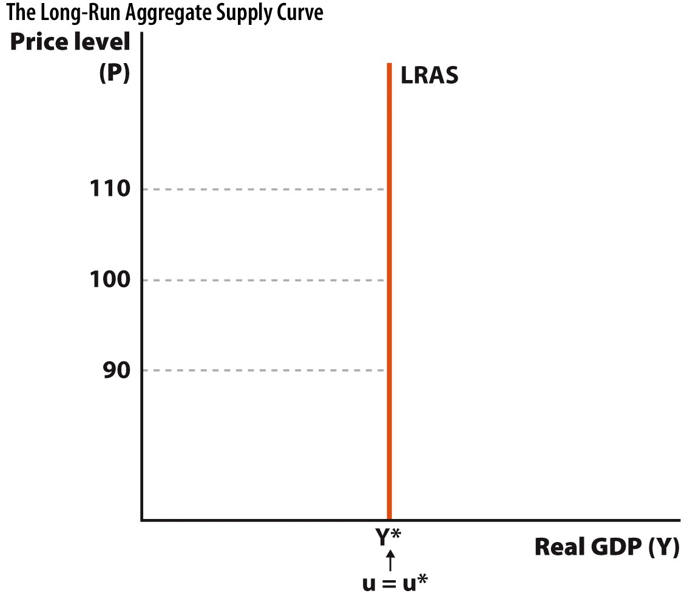
Long-Run Aggregate Supply Curve
Y* = Full Employment Output when u = u*
Y = Actual Output
u = Actual Rate of Unemployment
u* = Natural Rate of Unemployment
Full Employment Output (Y*): The rate of production achieved by the economy in the long-run when unemployment is at its natural rate.
Notes:
The vertical nature of the curve shows that in the long run, when all prices are able to adjust, output is independent of price level. The price level can rise and fall, and output will remain the same.

Slide 37
Change in Long-Run Aggregate Supply
Change in LRAS:
Change in the amount of a national's long-run output/growth.
SHIFT in LRAS!
Decrease in LRAS: Left shift.
Increase in LRAS: Right shift.
Long-Run Aggregate Supply Shifters:
Change in Technology ➔ A positive relationship.
Change in Resources ➔ A positive relationship.
Change in Institutions ➔ A positive relationship.
Notes:
Money is essentially just green pieces of paper. How does the extra money affect the quantity of output, or real GDP, in the economy? The extra money does not affect the supply of labor, capital, amount of natural resources, or technological knowledge—all of those are identical across the economies. This means that the extra money in circulation is chasing the same output so it takes 10 times the money to buy goods and services than it does in the economy with less money.
Causes of growth are resources, technology, and institutions. Therefore, long-run growth (and a shift in the long-run AS) occur when changes to these three causes happen!

Slide 38
Shifts in Long-Run Aggregate Supply Curve
Notes:
Shifts in the long-run aggregate supply curve occur when there is a change in an economy's resources, technology, or institutions. A technological advance moves an economy from LRAS to LRAS₁. This is a picture of economic growth. When the LRAS curve shifts to the right, this movement also indicates a change in the economy's full employment output level from Y* to Y**. The unemployment rate does not change, but workers are more productive.

Slide 39
Short-Run Aggregate Supply Curve
Graph of the relationship between AQS and price level.
Positively-sloped: Why?
Positive relationship between aggregate quantity supplied and the price level: Depends on the price level.
An increase in the price level generates profit opportunities which lead to an increase in aggregate quantity supplied.
Nominal price level affects real GDP in the short run, leading to an upward-sloping SRAS.
Short-Run: Some prices adjust immediately, others don't.
Prices are sticky.

Slide 40
Short-Run Aggregate Supply Curve
Notes:
The positive slope of the short-run aggregate supply curve indicates that increases in the economy's price level lead to an increase in the quantity of aggregate supply in the short run. For example, if the price level rises from 100 to 110, the quantity of aggregate supply rises from $16 trillion to $17 trillion in the short run. The reason is that some prices are sticky in the short run.

Slide 41
Short-Run Aggregate Supply Curve
On the same Short-Run AS curve (SRAS):
Input prices are fixed.
The availability and quality of productive resources in the economy are fixed.
Technology does not advance.
Number of sellers is fixed over the given period.

Slide 42
Change in Short-Run Aggregate Quantity Supplied
Aggregate Quantity Supplied (AQS):
The total amount of final products (measured by Real GDP) that will be supplied by producers at a given price level.
Change in AQS:
Change in the amount of a national production caused only by a change in the price level.
Caused by a change in the price level.
Movement along the SRAS curve.
NO SHIFT!

Slide 43
Change in Short-Run Aggregate Supply
Change in SRAS:
Change in the amount of a national production caused only by something other than a change in the price level.
SHIFT in SRAS!
Decrease in SRAS: Left shift.
Increase in SRAS: Right shift.

Slide 44
Shifts in Short-Run Aggregate Supply
Factors that shift only the short-run AS curve:
Input prices ➔ A negative relationship.
Temporary supply shocks ➔ A positive relationship.
Changes in expected future prices ➔ A negative relationship.

Slide 45


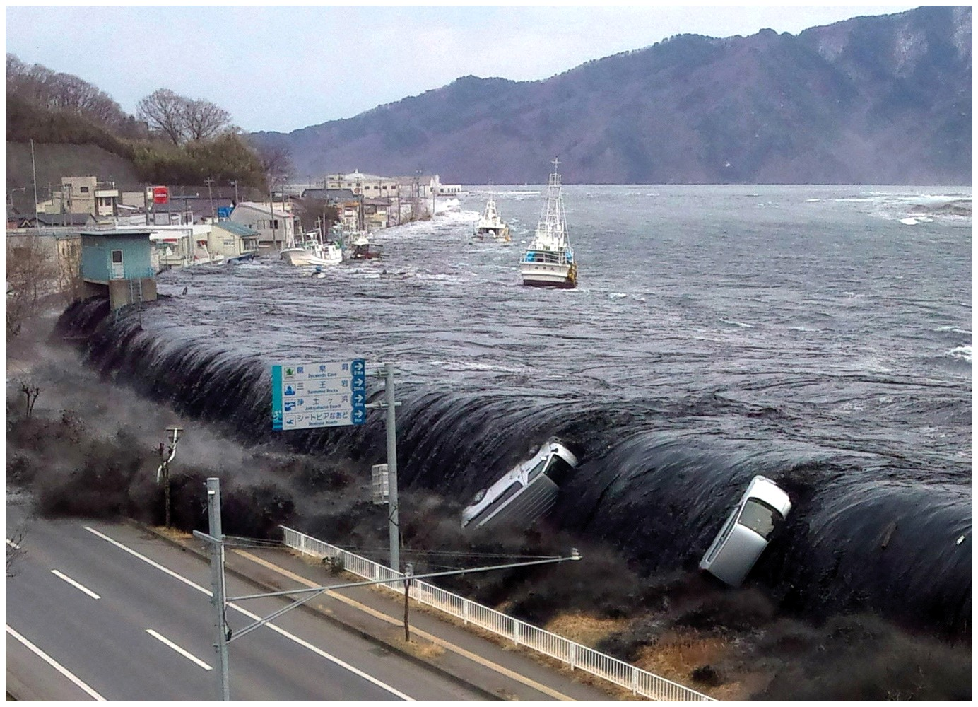
Shifts in Short-Run Aggregate Supply
Supply shock:
An event that affects aggregate supply
Drought, hurricane, oil shock
Notes:
A Midwest drought would be an example of a temporary supply shock.
Any "shock" that destroys a large supply of goods will shift AS to the left.
Pictures show frozen orange crops and a tsunami.

Slide 46
Shifts in Short-Run Aggregate Supply
Expected future price levels:
If workers and firms expect higher prices tomorrow, they negotiate those expectations into today's contracts.
Costs are higher, and the short-run AS shifts left.
However, it does not affect long-run production possibilities, so the long-run AS doesn't change.
Notes:
If inflation expectations suddenly jump to 14%, this affects contracts signed today. When workers and firms expect higher prices, they negotiate labor contracts with higher nominal wages. This leads to higher labor costs, which reduces profitability, and makes firms less willing to produce at any price level. Therefore, the short-run aggregate supply curve shifts left.

Slide 47
Shifts in Short-Run Aggregate Supply Curve
Shift Factor | Positive Change in Factor Leads to: | Negative Change in Factor Leads to:
Input Prices | Decrease to SRAS₃ | Increase to SRAS₂
Supply Shock | Increase to SRAS₂ | Decrease to SRAS₃
Expected Price Level | Decrease to SRAS₃ | Increase to SRAS₂
Notes:
The short-run aggregate supply curve shifts to the right when there are positive supply shocks, decreases occur in expected price levels, and anticipated price levels turn out to be too high. The curve shifts to the left when there are negative supply shocks, increases occur in expected future prices, and anticipated price levels turn out to be too low.

Slide 48
Shifts in Short-Run Aggregate Supply
Long-Run shifts:
Whenever the long-run AS (LRAS) curve shifts, it takes the short-run AS (SRAS) curve with it.
Factors that shift both the long-run and short-run AS curve:
Changes in Technology ➔ A positive relationship.
Changes in Resources ➔ A positive relationship.
Changes in Institutions ➔ A positive relationship.

Slide 49
Shifts in Long-Run Aggregate Supply Curve

Slide 50
Macroeconomic Equilibrium
Macroeconomic Equilibrium is attained when the aggregate demand equals the aggregate supplied.
Aggregate production made available for sale over a given period is, on average, willingly purchased in markets at prevailing price level.
On Average: Some individual markets can be out of equilibrium even when a macroeconomic equilibrium is attained.

Slide 51
Long-Run Macroeconomic Equilibrium
Long-Run Macroeconomic Equilibrium:
If the macroeconomic equilibrium occurs at the level of "Potential Real GDP", it is called long-run equilibrium or equilibrium at full employment.
Full Employment Output = Potential Real GDP = Natural Rate of Output
SRAS = AD where SRAS = LRAS
When the long-run equilibrium is achieved the economy will be on the short-run equilibrium as well.
Economy is at the Long-Run Trend:
Operating at "Natural Rate of Output" and "Natural Rate of Unemployment."
u = u* and Y = Y*

Slide 52
Long-Run Macroeconomic Equilibrium
Notes:
The long-run equilibrium in the economy occurs after all participants in the economy have had a chance to adjust fully to the price level. This figure is the primary representation of the aggregate demand and aggregate supply model—it represents long run equilibrium (at point A), the point toward which the economy is moving at any point in time.
At this equilibrium output level, short-run expectations about the price level are consistent with the actual price level and the economy is operating at full employment. This provides an important frame of reference for evaluating the health of the economy. In the short run, the intersection of aggregate demand and short-run aggregate supply can deviate from the economy's long-run potential. This means that output, at any given moment, may be more or less than the natural rate shown by Y*.
The notion that the economy's short-run performance deviates from its long-run potential is captured by the business cycle—recessions and expansions.

Slide 53
Short-Run Macroeconomic Equilibrium
Short-Run Macroeconomic Equilibrium:
If the macroeconomic equilibrium occurs out of the level of "Potential Real GDP", it is called short-run macroeconomic equilibrium.
SRAS = AD where SRAS ≠ LRAS
Economy is out of the Long-Run Trend:
Not operating at "Natural Rate of Output" and "Natural Rate of Unemployment."
u ≠ u* and Y ≠ Y*

Slide 54
Short-Run Macroeconomic Equilibrium: Expansion
Y > Y*
u < u*
What can we say about the inflation in the short-run?

Slide 55
Short-Run Macroeconomic Equilibrium: Contraction
Y* > Y
u* < u
What can we say about the inflation in the short-run?

Slide 56
Long-Run Macroeconomic Equilibrium: Expansion
Notes:
Beginning at long-run equilibrium point A, the price level is at 100 and output is at the natural rate (Y*). New technology shifts long-run aggregate supply positively from LRAS to LRAS1 because the economy can now produce more at any price level. The new long-run equilibrium is at point B, and there is now a new, higher natural rate of output (Y**). Note that the unemployment rate (u) is equal to the natural rate (u*) both before and after the shift.

Slide 57
The Classical Economics
Also known as "Classicals."
The Classical Model of Macroeconomic Equilibrium:
Wages and prices are flexible in both ways.
Self-correction mechanism
Correction through the price level and SRAS works very fast.
An increase or decrease in AD or in SRAS would set up market forces and eventually put the economy back in the Potential Real GDP (full employment output) and eliminate cyclical unemployment in the long-run.

Slide 58
The Classical Economics: Short-Run vs. Long-Run
Short-Run Macroeconomic Equilibrium:
Assume there is AD or SRAS shock in the economy.
Economy deviate from the Potential Real GDP (long-run trend).
Wages and prices cannot adjust in the short-run.
There are recessionary and inflationary real GDP gaps.
Happens only temporarily.
Long-Run Macroeconomic Equilibrium:
Wages and prices can fully adjust in the long-run.
Any recessionary and inflationary real GDP gaps are quickly eliminated through changes in the price level and SRAS.
Economy is on the Potential Real GDP (long-run trend).

Slide 59
The Classical Economics: Short-Run vs. Long-Run
Notes:
The figure illustrates the changes in the economy from increased consumer confidence. We start in long-run equilibrium at point A, where the price level is at P₁₀₀, we have the natural rate of output (Y*), and unemployment equal to the natural rate. Then aggregate demand shifts to from AD₁ to AD₂. This immediately moves us to short-run equilibrium at b (short-run equilibria are denoted with lowercase letters).
The short-run equilibrium implies higher prices (P = P₁₀₅), and higher real GDP (Y'). In addition, the unemployment rate drops to u', which is less than u*. Thus, in the short run, changes in aggregate demand do impact the real economy. This holds even if these aggregate demand changes are based purely on feelings.
As all prices adjust, the short-run aggregate supply curve shifts to the left from SRAS to SRAS1. This moves us to long-run equilibrium at point C. Notice that at C we are back to the original output level (Y*) and unemployment level (u*), but prices are higher (P = 110). The model is telling us that demand changes have no real effects in the long run because only the price level, a nominal variable, is affected.

Slide 60
The Classical Economics: Short-Run vs. Long-Run
Consider a oil pipeline break which causes temporary decrease in SRAS.

Slide 61
The Classical Economics: Critics
The Classical Model:
Prevailed until the Great Depression.
Great Depression (1929-1939):
Macroeconomic equilibrium was stuck at a level of real GDP much lower than the Potential Real GDP since wages and prices did not adjust as fast as expected.
Cyclical unemployment was very high.
Lasted 10 years.
Questions:
Should we wait for wage and price adjustments for 10 years?
Or should we do something else?
If so, who should do it?

Slide 62
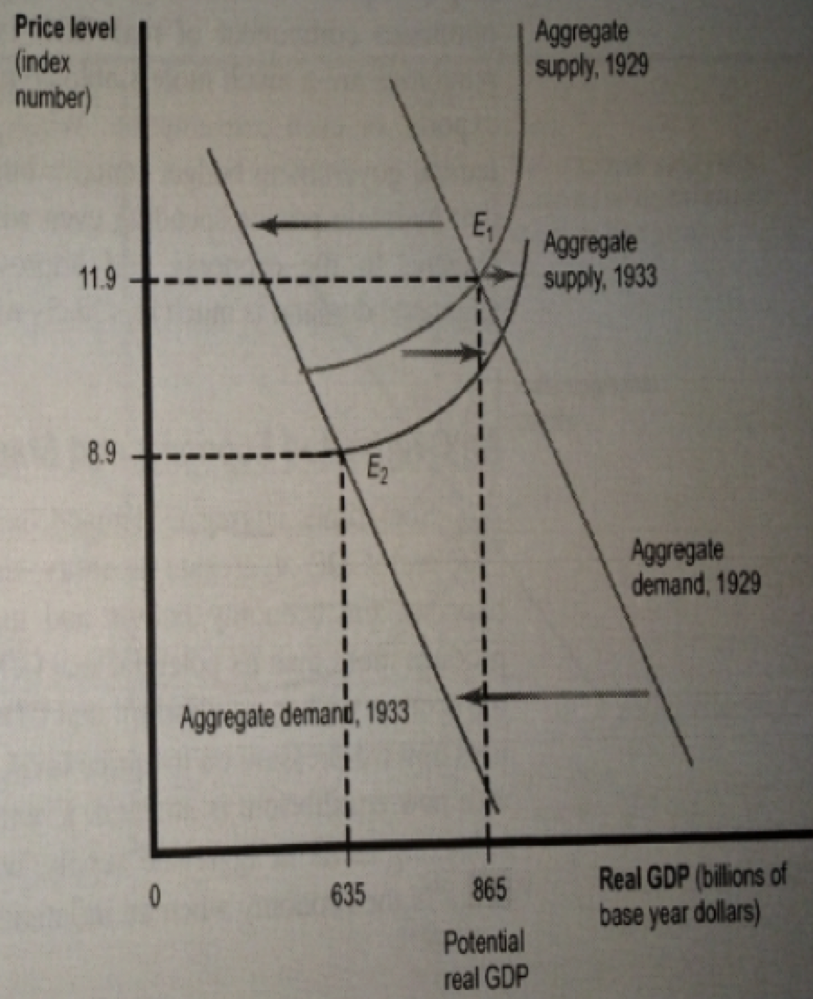
The Classical Economics: Critics
*Even after 4 years the wages and prices had not adjusted and the economy was still in a deep recession.

Slide 63
The Keynesian Economics
Also known as "Keynesians.": John Maynard Keynes
The Keynesian Model of Macroeconomic Equilibrium:
Wages and prices are sticky/rigid. Especially downward. Why?
Self-correction mechanism (proposed by the Classicals) doesn't work.
Correction through the price level and SRAS takes a very long time.
When there is an increase or decrease in AD or in SRAS, due to the sticky wages and prices (downwards especially), the self-correction mechanism can't be expected to automatically put the economy back in the Potential Real GDP (full employment output) and eliminate cyclical unemployment in the long-run.

Slide 64
The Keynesian Economics: Solution
John Maynard Keynes: "In the Long-Run, we are all dead"
Decreases in AD may never decrease the price level enough to reach points on the Potential Real GDP (points on LRAS).
Self-correction mechanism doesn't work well in the downward direction.
Short-run action is necessary.

Slide 65
The Keynesian Economics: Solution
Recessions requires short-run actions to increase aggregate demand:
Who should do this "short-run" action?
Remember the 3 main actors in the economy: Consumers, Producers, and the Government.
AD = GDP = C + I + G + NX
Government Policy:
Government Purchases: Increase it to stimulate G and increase AD.
Government Taxes: Decrease it to stimulate C and I and increase AD.
Government Transfers: Increase it to stimulate C and increase AD.

Slide 66
Practice What You Know
With the AD-AS graph, what variable is on the vertical axis?
national income
the price of the good we are studying
the price of labor
the price level
Notes:
Correct answer: d
The price level is the OVERALL level of prices for goods and services in the economy. We're not looking at the price of a single good with this model.

Slide 67
Practice What You Know
The wealth effect can help explain
the positive slope of the AS curve.
the negative slope of the AD curve.
the difference between real and nominal GDP.
the rate of economic growth.
Notes:
Correct answer: b
The wealth effect refers to the change in the purchasing power of money when the price level changes. If the price level falls, we can afford to buy more goods with the same number of dollars.

Slide 68
Practice What You Know
Consider just the AD curve. Suppose consumption [C] broadly increases across the entire economy. This will cause
a movement along the AD curve.
the AD curve to shift outward.
the slope of the AD curve to get steeper.
a decrease in the price level of the economy.
Notes:
Correct answer: b
If everyone spends more (perhaps due to higher consumer confidence), the AD curve will shift. Specifically, it will shift outward (to the right). Combined with the AS curve, the model shows that this will result in higher real GDP and a higher price level.

Slide 69
Practice What You Know
Why is the LRAS curve vertical?
The short run sets a given output that will remain in the long run.
Long-term output can only increase at a specific equilibrium price level.
Prices have nothing to do with long-term output.
Unemployment is zero in the long run.
Notes:
Correct answer: c
In the long run, all prices have time to fully adjust. If two economies have identical goods, services, populations, skills, and resources, they will have the same real output even if one economy has twice as much money (and prices that are twice as high).

Slide 70
Practice What You Know
Suppose there is an increase in AD, causing a price level increase, what will happen in the long run as prices adjust?
The price level will go back to its previous level.
The price level will rise even further.
The price level will fall to a level below its previous level.
The price level will fall slightly to a level somewhere between its current level and the original level.
Notes:
Correct answer: b
Over time, as prices adjust, the SRAS will shift back left such that the equilibrium between AD and SRAS will once again intersect LRAS. This left shift of SRAS will make the price level rise further.

Slide 71
Sources
"Principles of Economics with Smartwork Access (ISBN: 978-0-26314-5), 1st Edition, 2013" by Mateer and Coppock
"Economics: Custom Edition for NCSU (ISBN: 9781937435202" by David Hyman

